Slide 1
Lab 07
Logic Minimization Using Truth Table
Source: Purdue’s notes

Slide 2
EXPERIMENT DESCRIPTION:
A distinguished (yet unnamed) instructor has asked you to design a circuit that calculates course grades, based on the letters in students’ last names. The “key letters” chosen for this semester are “I”, “D”, “G”, and “P”.
A course grade of “A” will be given to students who have the vowel (“I”) and at least two of the three consonants (“D”, “G”, or “P”) in their last name (e.g., “Dig”).
A course grade of “B” will be given to students who don’t have the vowel “I” in their last name but do have at least one of the three consonants in their last name (e.g., “Pay”).
A course grade of “F” will be given to all other students (i.e., those who do not receive an “A” or a “B”).

Slide 3
EXPERIMENT STEP (1):
Create a truth table for the grading circuit (note that it has four inputs and three outputs), map and minimize all three functions.
For each of three functions, compare the SoP cost to the PoS cost, and choose the one that is “cheapest” to implement.
Show all your work on a separate sheet and have it available for your lab instructor to check.

Slide 4
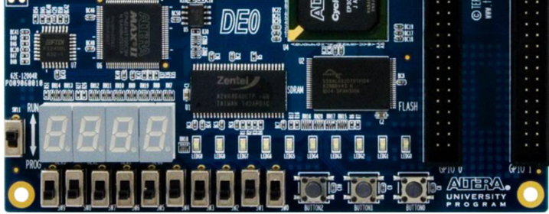
EXPERIMENT STEP (2):
Using Quartus II, create a schematic for implementing your grade assignment circuit based on the experiment step (1) result.
Download your grade assignment circuit to DE0, using a switch for each input and three LEDs for “A”, “B” and “F” outputs.
Keep track of the amount of time it takes you to complete this step
I
D
G
P
F
B
A

